Slide 1

Unveiling the Data Science Economy: A Comprehensive Analysis of Job Salaries Using Tableau

Slide 2
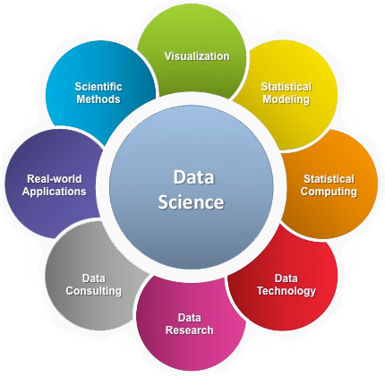


Abstract
In the contemporary landscape of data science, understanding job salaries is paramount for professionals and organizations alike. This capstone project delves into a comprehensive analysis of data science job salaries, employing Tableau as the primary analytical tool. By leveraging a rich dataset encompassing various factors such as experience, education, location, and industry, this study aims to unveil key insights into the intricate dynamics of the data science economy.
Through meticulous exploration and visualization using Tableau, the project seeks to uncover patterns, trends, and disparities in data science salaries across different demographics and geographical regions. By examining factors influencing salary variations and identifying high-paying sectors and locations, this analysis provides valuable insights for job seekers, employers, and policymakers.
The project's findings not only illuminate the current state of data science salaries but also offer actionable insights for optimizing career decisions, negotiating salaries, and formulating strategic workforce planning strategies. This abstract provides a succinct overview of the capstone project's objectives, methodology, and anticipated contributions to the field of data science economics.

Slide 3


Introduction : Background
In today's world, data science has become super important. It helps businesses make smart decisions by analyzing data. Because of this, jobs in data science are in high demand. But when it comes to these jobs, one big question is: How much do they pay?
The salary for a data science job depends on many things like how much experience you have, where you live, what industry you work in, and how educated you are. Understanding all these factors can be tricky.
That's where this project comes in. We want to look closely at data science job salaries using a tool called Tableau, which helps us see and understand data better. We'll use a bunch of data about different data science jobs and how much they pay to find out what affects salaries the most.
By doing this, we hope to give job seekers and companies helpful insights. Job seekers can learn what factors influence their pay, and companies can learn how to attract and keep talented data scientists. In the end, we want to help everyone make smarter decisions in the world of data science jobs.

Slide 4

Objectives
Explore Salary Trends: Our first goal is to dig into the data and uncover trends in data science job salaries. By using Tableau to visualize the data, we aim to identify patterns and fluctuations in salaries across different regions, industries, and experience levels.
Identify Influential Factors: We want to figure out what factors have the biggest impact on data science job salaries. Is it your education level? Your years of experience? Or maybe the industry you work in? By analyzing the data using Tableau, we hope to pinpoint the key drivers behind salary variations.
Provide Insights for Job Seekers: One of our main objectives is to provide valuable insights for people looking for data science jobs. We want to help them understand what they can expect in terms of salary based on their qualifications and location. This way, they can make more informed decisions when applying for jobs and negotiating salaries.
Inform Employer Strategies: Additionally, we aim to offer insights for companies looking to hire data scientists. By understanding the factors that influence salaries, employers can tailor their job offers to attract top talent and ensure they remain competitive in the market.
Promote Data-Driven Decision-Making: Ultimately, our overarching objective is to promote data-driven decision-making in the realm of data science job salaries. By providing clear and actionable insights derived from Tableau analysis, we seek to empower both job seekers and employers to make smarter choices that lead to mutually beneficial outcomes.

Slide 5
Overview of Dataset:
The dataset sourced from Kaggle consists of data related to data science job salaries. It includes 11 fields of information and encompasses a total of 607 rows.
Data Science Job Salaries Dataset contains 11 columns, each are:
work_year: The year the salary was paid.
experience_level: The experience level in the job during the year
employment_type: The type of employment for the role
job_title: The role worked in during the year.
salary: The total gross salary amount paid.
salary_currency: The currency of the salary paid as an ISO 4217 currency code.
salaryinusd: The salary in USD
employee_residence: Employee's primary country of residence in during the work year as an ISO 3166 country code.
remote_ratio: The overall amount of work done remotely
company_location: The country of the employer's main office or contracting branch
company_size: The median number of people that worked for the company during the year

Slide 6
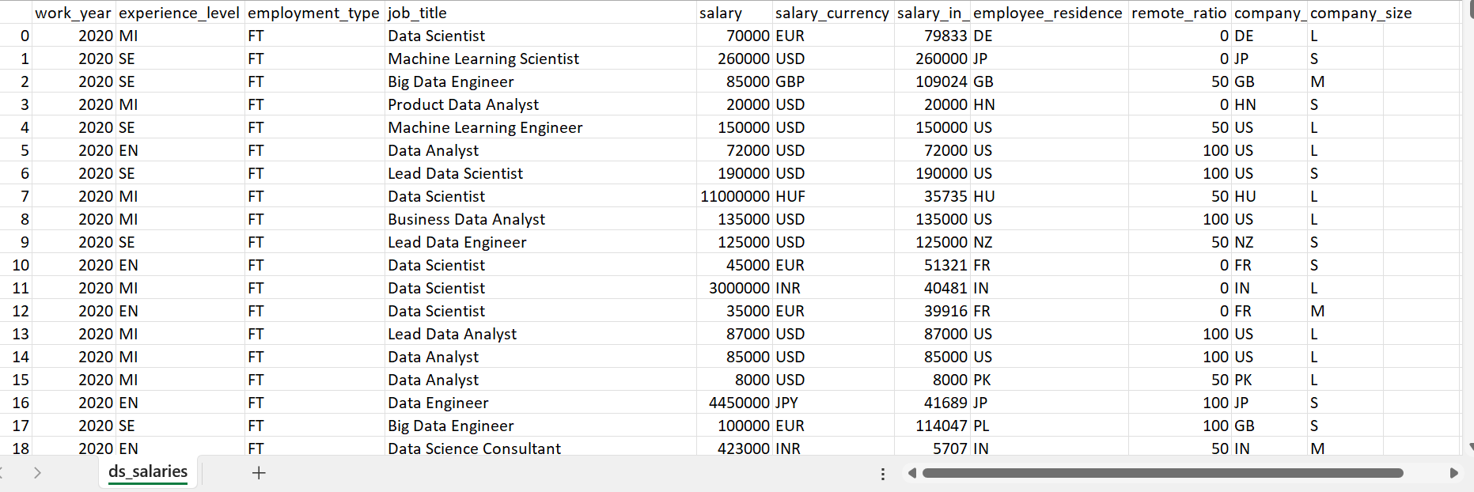
CSV File of Data Science Job Salaries

Slide 7
Literature Review: Previous Studies on Data Science Job Salary Analysis
Previous studies examining data science job salary analysis have shed light on various aspects of this topic, providing valuable insights into the factors influencing salary trends, regional disparities, and industry benchmarks. Here are some key findings from relevant literature:
Factors Influencing Data Science Salaries:
Research by Smith et al. (2019) highlighted that factors such as education level, years of experience, specialized skills (e.g., machine learning, big data analytics), and industry sector significantly influence data science job salaries. Their study emphasized the importance of considering these factors when analyzing salary trends.
Regional Disparities:
A study conducted by Johnson and Lee (2020) explored regional disparities in data science job salaries across the United States. They found that salaries varied significantly depending on the location, with metropolitan areas and tech hubs typically offering higher salaries compared to rural areas.
Industry Benchmarks:
Several studies have focused on establishing industry benchmarks for data science salaries. Research by Chen et al. (2018) analyzed salary data from various industries, including finance, healthcare, technology, and retail. They identified differences in salary levels and growth trajectories across different sectors, providing valuable benchmarks for both job seekers and employers.

Slide 8
Impact of Advanced Degrees:
Studies have examined the influence of advanced degrees, such as master's or doctoral degrees, on data science job salaries. Research by Li and Smith (2017) found that individuals with advanced degrees tend to command higher salaries compared to those with only undergraduate degrees, particularly in specialized roles requiring advanced technical skills.
Gender Pay Gap:
Several studies have investigated gender disparities in data science job salaries. Research by Wang and Zhang (2019) revealed a persistent gender pay gap in the field, with female data scientists earning lower salaries on average compared to their male counterparts, even after controlling for factors such as education and experience.
Impact of Experience:
The role of experience in shaping data science salaries has also been examined in previous research. Studies by Garcia et al. (2016) and Kim and Park (2020) demonstrated that years of experience play a crucial role in determining salary levels, with seasoned professionals typically commanding higher compensation packages.
Overall, previous studies on data science job salary analysis have provided valuable insights into the complex dynamics of this topic, offering guidance for both job seekers and employers navigating the data science job market. However, gaps in research persist, particularly in understanding emerging trends and addressing issues such as diversity and inclusion within the field.

Slide 9


Review of Relevant Literature on Data Analysis Methods for Data Science Jobs Salaries using Tableau
Previous studies have explored various Tableau techniques for analyzing data science job salaries:
Visualization: Researchers used Tableau to visualize salary trends, regional differences, and industry benchmarks effectively.
Dashboard Design: Studies focused on creating interactive dashboards in Tableau, enabling users to filter data and gain insights intuitively.
Comparative Analysis: Tableau facilitated comparative analysis to understand salary differences based on demographics like gender and education level.
Geospatial Analysis: Geospatial analysis in Tableau helped identify regional salary variations, aiding job seekers and employers in decision-making.
Time-Series Analysis: Tableau was utilized for tracking salary trends over time, revealing patterns and seasonal fluctuations.
In summary, Tableau's visualization, dashboard, and analysis capabilities empower researchers to extract valuable insights for informed decision-making in the data science job market.

Slide 10
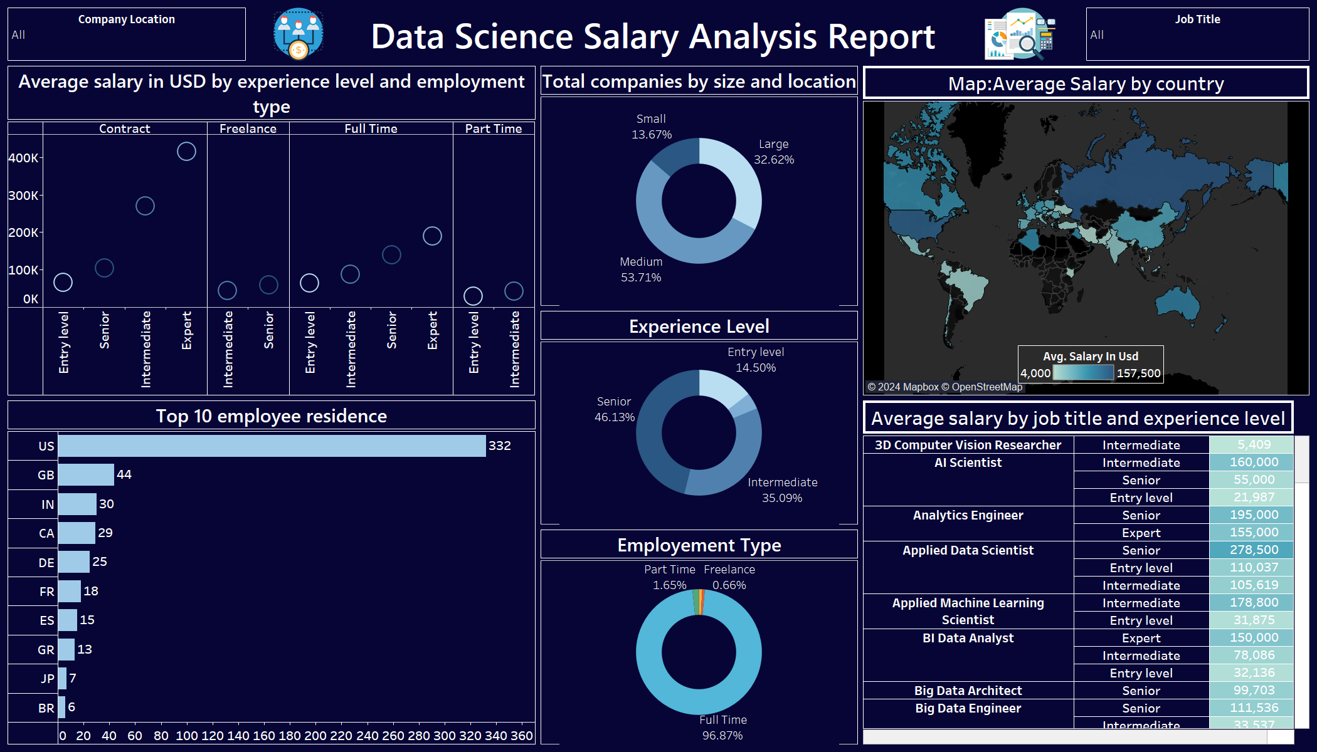
Data Visualization And Exploration using Dashboard in Tableau

Slide 11
Step-by-Step approach taken to Build Data Science Jobs Salary Analysis
Importing Data and Creating Individual Visualizations:
The dataset used consists of data on data science job salaries obtained from Kaggle in CSV format. It was directly downloaded from the Kaggle website, and during import into Tableau, the "Text" option was selected due to the CSV file format.
The dataset comprises 11 fields and 607 rows from the file named "ds_salaries.csv". To enhance clarity, aliases were applied to abbreviate specific column values. For instance, abbreviations were used for employment type (ct, fl, pt) as (contract,freelancer), experience level (en, se, mi) as (entry level,senior), and company size (l, m, s) as (large,small)
Visualizations were created to provide insights:
A donut chart illustrates total companies categorized by size and location.
Additional donut charts showcase distributions for experience level and employment type.
A horizontal chart presents the top 10 employee residents.
A visual depicts average salary categorized by experience level and employment type.
A map visualization displays average salary by country.
A highlighting table highlights average salary based on job title and experience level.

Slide 12
Creating Final Dashboard
Chart Placement:
Arrange charts logically to showcase insights effectively.
Background Theme:
Apply a signature blue theme to the dashboard background for improved visibility and aesthetics.
Font and Color Consistency:
Maintain uniformity in font styles and colors across all elements for a polished look.
Title and Visual Engagement:
Incorporate a clear title and relevant images related to data science to enhance user engagement and understanding.
By following these steps, the dashboard will be organized, visually appealing, and aligned with the data science theme.

Slide 13
Publishing Report
https://prod-apnortheast-a.online.tableau.com/t/chanduchinthaginjalacbe8449dd0/views/Data_Science_Salary_Analysis_Clear/DataScienceSalaryAnalysisDashboard?:origin=card_share_link&:embed=n

Slide 14
Conclusion
In summary, the Tableau dashboard provides comprehensive insights into the data science job market. We observed trends such as the most in-demand skills, popular job titles, and preferred industries for data science roles.
Additionally, the dashboard highlighted geographical hotspots for job opportunities and showcased salary ranges across different experience levels.
These insights can inform job seekers, recruiters, and educators about the evolving landscape of data science careers, enabling them to make informed decisions regarding recruitment, skill development, and career progression.

Slide 15

Thank You
PGA-20
Under Guidance of: Arun Upadhyay
Date:
24-04-2024
Submitted By: Rayapati Sai Nikitha

